Slide 1
Prof. Subodh Wagle, IIT Bombay
TD 638: Development Perspectives
Early Mainstream Development Theories

Slide 2
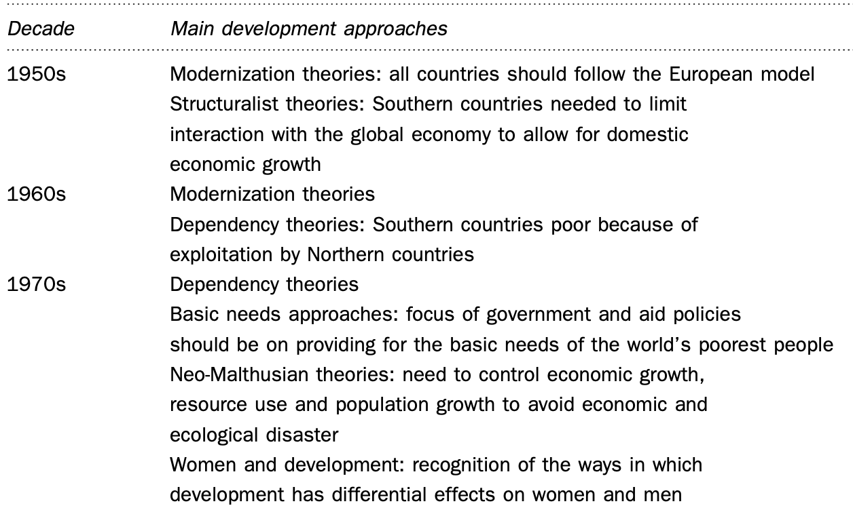
Main Approaches to Development: 1950s Onwards . . . 1

Slide 3
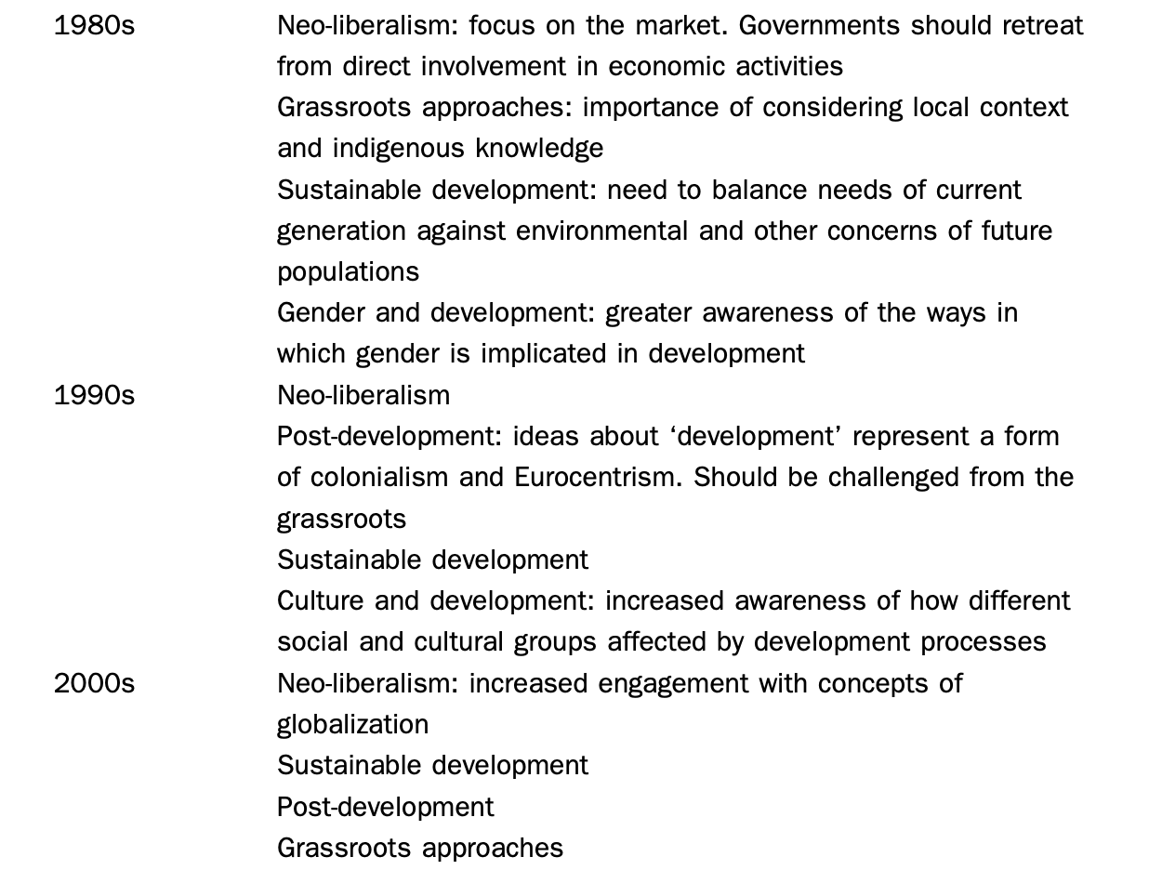
Main Approaches to Development: 1950s Onwards . . . 2

Slide 4
Early Thinking about ‘Development’: Keynes and Rostow
W W. Rostow (1950s):
Addressed concerns of US elites during Cold War:
Concern: whether newly independent countries in the Global South will side with USSR.
Rostow proposal: US aid to developing countries could help newly independent countries
to move rapidly through the stages of economic development
while keeping them in the capitalist/Western sphere of influence.
Rostow postulated that economic development as done in Western industrialized countries
could be replicated in developing world by applying a five-stage model (Representative of modernization theory).
Rostow’s theory and advice was followed by US and Western European governments in providing Development Aid

Slide 5
Early Thinking about ‘Development’: Rostow’s Model . . 1
W. W. Rostow postulated that economic development as done in Western industrialized countries
could be replicated in developing world by applying a five-stage model (Representative of modernization theory).
Rostow’s Five-Stage Model of Development
Initial Stage: Traditional State of economy, politics, and culture
Economic: Developing societies mostly agricultural, focused on subsistence (no surplus),
and employing their economic surpluses for military or religious goals rather than for economic improvement.
Political: Though liberated from colonial masters, native Feudal interest groups have strong political control
Feudal interest groups thriving on agricultural rent and not interested in development of industries or markets.
Socio-Cultural: Social norms and cultural practices restrict political and economic freedom
And restrict development of markets or industries

Slide 6
Early Thinking about ‘Development’: Rostow’s Model . . 2
Second Stage: Transition Stage:
Subversion of previous stage through development of internal and external markets
Markets allow the sale of agricultural commodities and the import of new goods, along with foreign technology.
This process creates interests groups in favour of increasing production and accumulating wealth
for secular and civil purposes (and not for military or religious purposes).
These changes in economy force changes in traditional culture shake up the pre-existing political order.
The increased economic activity, presence of interest groups, and loosening of political and cultural constraints
create a push toward more productive economic specialization in manufacturing,
and interest in the diversification of economic and trading opportunities
These developments, in turn, create the conditions for the third stage.

Slide 7
Early Thinking about ‘Development’ : Rostow’s Model . . 3
Rostow’s Five-Stage Model of Development [Continued]
Third Stage: Take-off Stage: Crucial because this is when developing countries start switching
to large-scale agriculture and industry, thus causing rapid urbanization and social change.
The pressures of urbanization and industrialization create demand for
significant investments in basic services such as electrification, roads, and seaports
and drastic improvements in education systems.
For Rostow, these all were areas where Western aid and advice could and should be employed.

Slide 8
Early Thinking about ‘Development’ : Rostow’s Model . . 4
Rostow’s Five-Stage Model of Development [Continued]
Fourth Stage: Drive to Maturity Stage: Tendencies from the Third Stage deepen.
Economic terms: Developing Countries more diversified and less reliant on imports to cover necessities.
As local firms invest to increase the volume and quality of their Industrial and agricultural production,
and adapt or create their own technologies.

Slide 9
Early Thinking about ‘Development’ : Rostow’s Model . . 5
Rostow’s Five-Stage Model of Development [Continued]
Fifth and Last Stage: Mass Consumption Society Stage: Stage already attained by industrialized Western economies.
Economies of Developing Countries completely industrialized,
with productive capacity enough to satisfy the consumption needs of citizens,
including financing imports with exports of goods and services
While Rostow’s stages of growth model is rarely invoked in development policy analysis today,
It has still remained as an influential undercurrent for Western policy-making toward the Global South.

Slide 10
Early Thinking about ‘Development’ : Rostow’s Model . . 6
What are the Main Drivers of Development: Comparing Gerschenkron, Keynes, and Rostow
Gerschenkron: premeditated planning will transform economy of newly independent countries in short time
Keynes: The state needs to make efforts to jump stages of development by accelerating economic growth
Rostow: International Aid + State’s efforts + International trade + Domestic investments
will be required for development of newly independent countries
Core Keynesian idea applied to development
Jumping stages of development by accelerating economic growth and modifying economies,
using forces other than the market, namely, the state.

Slide 11
Development Economics: New Disciplines in Development Thinking . 1
Development Economics: New discipline (in the late 1940s and lasted until the early 1960s)
Paul Rosenstein-Rodan: “Big Push” Theory:
Concentrating development efforts in specific and large industrialization projects (“Big Push”)
Projects with high capability to create “ripple effects” in the rest of the economy.
“Ripple Effects = (Such projects) enable technological development and additional economic activities
in other sectors of economy and other sections of society (leading to economic growth).
Measured by number of jobs and new businesses created in primary, secondary, and tertiary sectors of economy.
Example: Creation of heavy industries such as steel plants (also seaports, road bridges, and energy generation plants)
the output of which would later be used in the production of other goods,
such as rail cars and train tracks, ships, and heavy trucks.

Slide 12
Development Economics: New Disciplines in Development Thinking . 2
Development Economics: New discipline (in the late 1940s and lasted until the early 1960s)
Paul Rosenstein-Rodan: “Big Push” Theory: [Continued]
Construction and operation of these specific and large industrialization projects
also require transfer of significant technology and skills to developing countries from developed countries.
(technology and skills building, planning, and project management)
Due to their very high costs and requirements for technical knowledge,
these projects typically needed to be funded through foreign aid,
thus establishing another powerful argument and agenda for official development assistance /aid .

Slide 13
Development Economics: New Disciplines in Development Thinking . 3
Albert Hirschman (economist and Advisor to World Bank): Also supported the idea:
Big industrial projects in strategic industries and large infrastructure investments triggering economic modernization
Hirschman pointed out another gain from injections of foreign technology and capital, through international aid
Create linkages with the rest of the economy
Linkages (Concept) emphasizes that a given strategic industrialization can stimulate the development of other industries,
including some local industries that provide inputs (backward linkages)
and other industries that process outputs (forward linkages) for these new strategic industrialization projects.
Backward and forward linkages could jumpstart multiple sectors of an underdeveloped economy
Condition: Such linkages would develop only if state policies required
utilization of locally made inputs and local processing of outputs before exporting.

Slide 14
Development Economics: New Disciplines in Development Thinking . 4
Arthur Lewis: Another critical link: Theory of Surplus Labour
Arthur Lewis: Pointed out that industrialization could be promoted in developing countries
by encouraging labour to move from rural areas, where they worked in subsistence farming or plantations,
to urban areas to work in industry, without raising wages.
which would generate significant surplus.
Theory of Surplus Labour implied that such industrialization
could achieve large profits in its early stages,
which could later be reinvested in technology adaptation or endogenous innovations,
making economic development a self-sustaining project (Lewis 1954).

Slide 15
Development Economics: New Disciplines in Development Thinking . 5
Ragnar Nurske: Theory of Balanced Growth (of Industries and Agriculture) through State Investment,
Export Pessimism: Observed that much of the growth of imports in developing countries was wasteful.
consisted of luxury and superfluous consumption
Nurske advocated (instead) for increased taxation of commodity exporters and the wealthy
to finance state-led industrial and agriculture projects that would diversify the economy,
substitute for imports of manufactured goods, and repress demand for luxury items.
Such thinking dovetailed with
Rosenstein- Rodan arguments for “big push” projects, and ripple effect
Hirschman’s ideas of “linkages,”
and Rostow’s stage sequencing of growth.

Slide 16
Development Economics: New Disciplines in Development Thinking . 6
Import Substitution Industrialization (ISI):
Premise: By protecting or shielding them from foreign competition,
local infant industries in developing countries could grow significantly
Allowing them to earn great profits in local markets
that would be later invested in new industries and technologies,
gradually creating a more industrialized economy
with higher value-added production than one based on unprocessed commodities.

Slide 17
Development Economics: New Disciplines in Development Thinking . 7
Rosenstein-Rodan arguments for “big push” projects, Hirschman’s ideas of “linkages” and state intervention, and Rostow’s stage sequencing of growth, Nurske idea of heavy taxation.
All involved departures in development economics from traditional free-market Economics (Liberal Economics)
This departures Quite common in the 1940s to 1960s, since many economists of this period
did not accord international trade a significant role in strategies for development.
Their recent experience had been formed by
the Great Depression, with its fall in international trade flows,
the Second World War, when international trade had pretty much stopped,
and the early post-war period, when international trade remained heavily regulated
while Marshall Plan worked as State-State Collaboration for Reconstruction of Europe .

Slide 18
Thank You

